Slide 1
Gauss’ Law
Key contents
Electric flux
Gauss’ law and Coulomb’s law
Applications of Gauss’ law

Slide 2
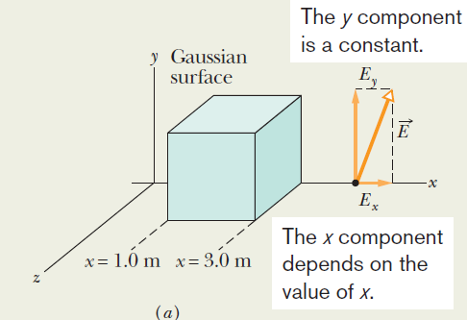
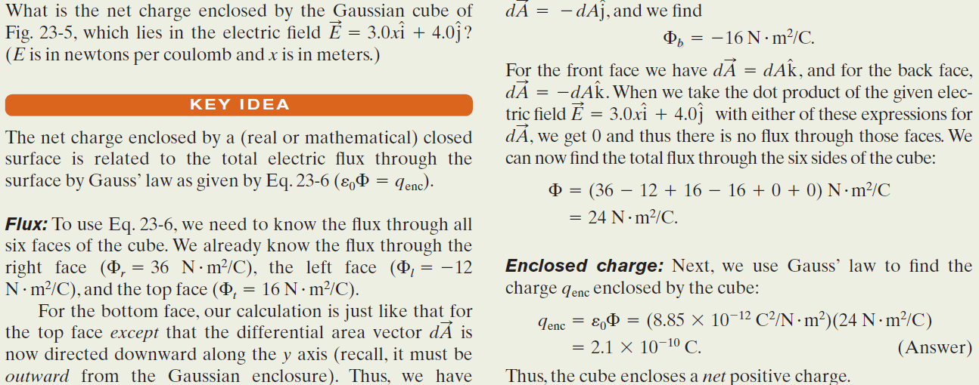
Example, Enclosed charge in a
non-uniform field:

Slide 3
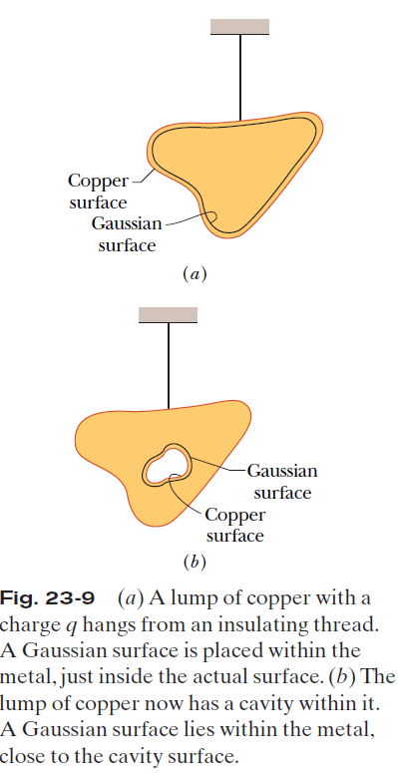
23.6 A Charged Isolated Conductor:
If an excess charge is placed on an isolated conductor, that amount of charge will move entirely to the surface of the conductor. None of the excess charge will be found within the body of the conductor.
Figure 23-9a shows, in cross section, an isolated lump of copper hanging from an insulating thread and having an excess charge q. The Gaussian surface is placed just inside the actual surface of the conductor. The electric field inside this conductor must be zero. Since the excess charge is not inside the Gaussian surface, it must be outside that surface, which means it must lie on the actual surface of the conductor.
Figure 23-9b shows the same hanging conductor, but now with a cavity that is totally within the conductor. A Gaussian surface is drawn surrounding the cavity, close to its surface but inside the conducting body. Inside the conductor, there can be no flux through this new Gaussian surface. Therefore, there is no net charge on the cavity walls; all
the excess charge remains on the outer surface of the conductor.

Slide 4
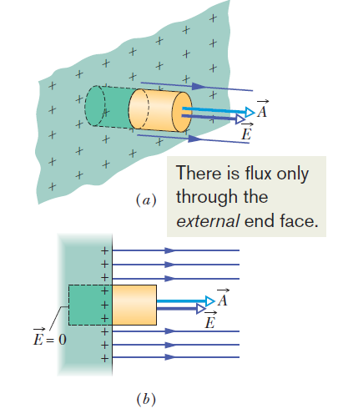

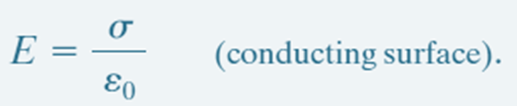
A Charged Isolated Conductor; The External Electric Field:
is the charge per unit area.
q_{enc} is equal to σA.

Slide 5
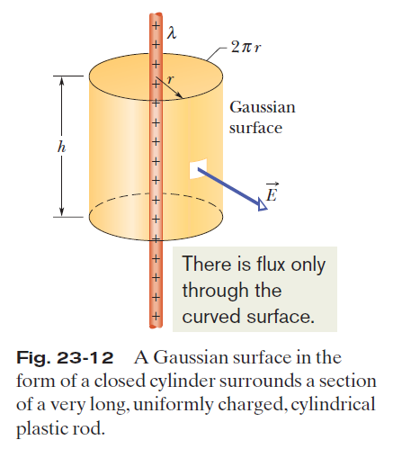
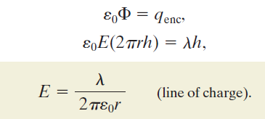
Applying Gauss’ Law and Cylindrical Symmetry:

Slide 6
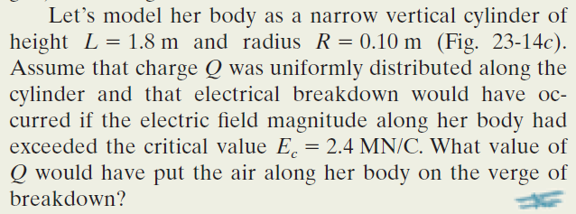
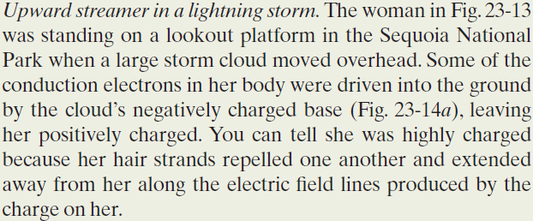
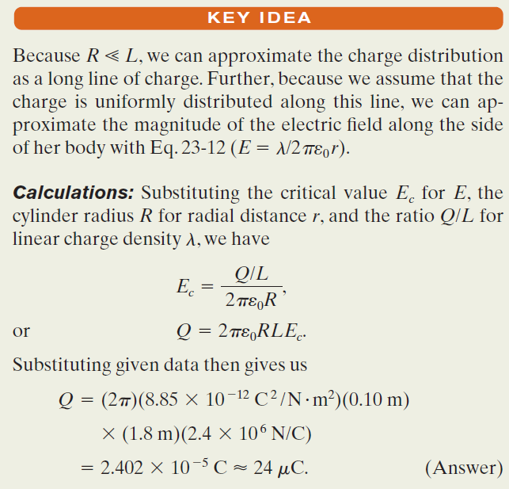
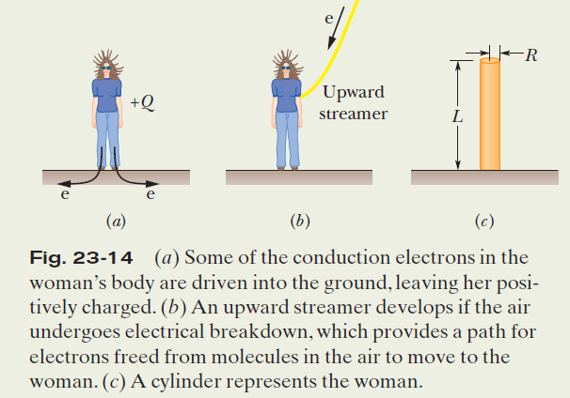
Example, Gauss’ Law and an
upward streamer in a lightning storm:

